Slide 1
Imagine Cup Junior
Lesson Three - What is generative AI?
Notes:
This is a title slide that you can have up at the beginning of Lesson 2 of the Imagine Cup Junior for Beginners.

Slide 2

Challenge Check-in
What have you done so far?
You formed a team and identified a specific problem from one of the AI for Good categories. You have formed a team, selected a problem, and learned more about it.
You have learned about the basics of AI and how to build with APIs.
What is next?
In this lesson, you are going to learn about the different kinds of AI, specifically generative AI, and how those kinds of AI are used in our world.
Notes:
Challenge Check-in. This slide is a check-in to recap what the students have learned so far and what is coming next!

Slide 3






What we will be doing across the six Imagine Cup Junior lessons.
Lesson 1
Lesson 2
Lesson 3
Forming your team and choosing your problem.
Learning about how AI works.
Learning about generative AI.
Lesson 4
Lesson 5
Lesson 6
Becoming a team of AI inventors.
Making sure your AI is good and cyber secure.
Entering a great submission to Imagine Cup Junior.
Notes:
This slide provides a short overview of the six lessons your class will take part in.

Slide 4
Submission Tips
Your team will be learning about the different kinds of AI in this lesson. To score well in Imagine Cup Junior keep in mind that you need to:
Ensure your team’s concept is AI, and that you have used the APIs.
Try to think of ways that it can truly solve your identified problem in a really powerful way using AI.
Explain what kind of AI your team has used in your concept (traditional rule-based or generative AI)
Notes:
These Submission Tips are designed to help you students to stay focused in this lesson, and ensure they are building their AI with the above points in mind.

Slide 5

What have we learned about AI already?
Class Reflection
Helpful Questions to Consider:
How would you define AI in your own words?
What are the three steps of how AI works?
What is an API?
Notes:
Rapid Reflection – To engage your students with this lesson, ask them to work in their teams (or as a whole class) to brainstorm what they remember from the prior lesson

Slide 6

AI is quite simply…
an attempt to make a computer, a robot, or other piece of technology ‘think’ and do some things like humans.
Notes:
Lesson 2 Recap: Here we review the definition of what artificial intelligence is. There are plenty of definitions out there, but in Imagine Cup Junior for Beginners we use this simple overview. ‘Artificial Intelligence is an attempt to make a computer, a robot, or other piece of technology ‘think’ and process data in the same way as we humans do.’
Artificial Intelligence is when computers are trained to try to do things that would usually require human intelligence. So basically, computers are taught how to “think” and perform tasks like humans.

Slide 7





APIs that sit under each of the cognitive services
There are many APIs that sit under each of the cognitive services. APIs are essentially software tools that AI developers can use to quickly and simply build out their AI ideas. Here is an overview of them, and you will explore them yourselves shortly.
Vision Computer Vision
Analyze content in images and video.
Custom Vision
Customize image recognition to fit your business needs.
Face
Detect and identify people and emotions in images.
Form Recognizer
Extract text, key-value pairs, and tables from documents.
Ink Recognizer Recognize digital ink and handwriting, and pinpoint common shapes.
Video Indexer
Analyze the visual and audio channels of a video, and index its content.
Speech
Speech to Text
Transcribe audible speech into readable, searchable text.
Text to Speech
Convert text to lifelike speech for more natural interfaces.
Speech Translation
Integrate real-time speech translation into your apps.
Speaker Recognition
Identify and verify the people speaking based on audio.
Language
Immersive Reader
Help readers of all abilities comprehend text using audio and visual cues.
Language Understanding
Build natural language understanding into apps, bots, and IoT devices.
QnA Maker
Create a conversational question and answer layer over your data.
Text Analytics
Detect sentiment, key phrases, and named entities.
Translator
Detect and translate more than 60 supported languages.
Search
Bing Image, News,Video & Web Search
Search across a wide range of terms.
Bing Custom Search
Create a custom search engine with ad-free results.
Bing Entity Search
Recognize and classify named entities, and find search results based on them.
and objects.
Bing Spell Check
Help users identify and fix word breaks, slang, names, homonyms, and brands.
Decision
Anomaly Detector
Identify potential problems early on.
Content Moderator
Detect potentially offensive or unwanted content.
Metrics Advisor
Monitor metrics and diagnose issues.
Personalizer
Create rich, personalized experiences for every user.
Notes:
Lesson 2 Recap: shows the five Microsoft Cognitive Services and the currently available APIs.

Slide 8
The 1,2,3 Step Process
Step 1
Data is collected.
Step 1
Data is collected.
Step 2
This data goes into the AI.
Step 2
This data goes into the AI.
Step 2
This data goes into the AI.
Step 3
A decision or outcome is created by the AI.
Notes:
Lesson 2 Recap: In our training of students around the world in AI, we have found the simple process that we step through in the next slides very easy for them to understand. Essentially AI can be thought of as:
Step 1: Data is collected.
Step 2: This is received by the AI.
Step 3: A decision or outcome is created.
We will use this approach in the coming lessons to help your students create their AI concepts, so this is an important process to help them understand. At Step 1, we can therefore ask the question of what data is collected, and also how it is collected. This is a good setup for the next video, which explains the Microsoft Cognitive Services and the very important tool called APIs.

Slide 9
Types of AI
General AI
Specific AI
Traditional Rule-Based AI
Generative AI
Notes:
This is where students are introduced to the two Types of AI- General AI and Specific AI.
General AI – doesn’t exist yet but would be capable of performing any task that a human could do and would have similar cognitive abilities. It would be able to reason, solve problems, learn from experiences, understand natural language, and adapt to situations and contexts.
Specific AI (aka Narrow AI)- is designed and trained for a particular kind of task or a limited range of tasks. It excels in performing predefined tasks but does not have human-like abilities beyond it’s intended scope. For example, a chatbot responds like a human in the language it generates, but only because it has been trained to do so, not because it is “thinking” on its own and has cognitive abilities. Within this type of AI exists two different kinds we’re focusing on in ICJ: traditional or rule-based AI and generative AI.

Slide 10
What is the difference?
Traditional Rule-Based AI
Generative AI
Rules guide the output (if-then logic).
Not flexible. Performs only in ways it was prepared for the AI in training but cannot adapt well.
Cannot create new things, only what it was programmed to do.
Highly predictable and consistent.
Large amounts of different kinds of data guide the output.
Can be very flexible if enough training and data are provided.
Can be very creative and produce new things like art, music, images, etc.
Not as predictable and consistent.
Notes:
The two kinds of Specific AI that we are learning about in ICJ are traditional rule-based AI and generative AI.

Slide 11
Examples
Traditional Rule-Based AI
Generative AI
SPAM email filter: Follows specific rules to decide if an email is SPAM and puts it in a SPAM folder (or deletes it).
Follows very specific rules
Cannot adapt on its own
Is not being creative or generating something “new”
Thermostat: When an environment gets too hot, it turns on the A/C; when it’s too hot, it turns on the heat.
Follows very specific rules
Cannot adapt on its own
Text summarization: Can process text and create a new, shorter, clear summary of the original text(s).
Responds flexibly based on extensive broad training
Creating something new
Natural disaster prediction: Uses many data sets to identify patterns and make predictions.
Adapts to new information
Creating predictions and projections based on multiple data sets and criteria
Notes:
To further students’ understanding about the two types of AI, it is important to walk through each example and explanation. This will prepare them for their first sprint coming up next.

Slide 12

Sprint 1
Real World Examples
Sprint 2
Revisiting your AI idea
Sprint One – Real World Examples
Goals:
As a team, go online to fine one example of each type of (traditional rule-based AI, generative AI) and explain how you were able to classify it.
Hints:
Consider looking at the flexibility of the AI, creativity, and the kind of training that may have been used to teach the AI.
Notes:
Sprint #1 – In the first ten-minute sprint of Lesson Three your students can work in their teams to go online to research and identify one example of each type of AI (traditional AI and generative AI) and explain how they could tell the kind of AI used in each concept.

Slide 13
Class Reflection
What made it difficult to determine the kind of AI used?
What helped your team determine the kind of AI in the examples you found?
Notes:
Rapid Reflection – As a way of bringing your students back from their sprint, this is a chance to reflect as a class, and again for you as their teacher to emphasize the difference between generative AI and traditional rule-based AI.

Slide 14
Submission Tips
You need to be able to recognize features of both traditional rule-based AI and generative AI so your team can provide a detailed explanation of the kind of AI your team used in your concept.
Notes:
This submission tip expands on one aspect of the Artificial Intelligence rubric row. The other two aspects are 1) the concept is actually AI, and 2) they can specify how APIs were used.

Slide 15
Sprint 1
Real World Examples
Sprint 2
Revisiting your AI idea
Sprint Two – Revisiting Your AI Invention from Lesson 2
In Lesson 2, you built an AI using the 123 Step Template to solve this challenge: ‘How can we use AI to reduce loneliness and depression amongst elderly people?’
Goals:
Revisit your AI from Lesson 2 and explain the kind of AI you used in your concept (traditional rule-based or generative AI) and make sure your API explanations are detailed.
Hints:
When explaining the kind of AI you used, remember to think about the flexibility of the AI, creativity, and the kind of training that may have been used to teach the AI.
Notes:
Sprint #2 – In the final ten-minute sprint of Lesson Three your students will work in their teams to revisit their AI idea from Lesson 2 (How can we use AI to reduce loneliness and depression amongst elderly people?’) When they revisit their idea, they must now add details about the kind of AI they used (traditional rule-based or generative) and explain the APIs they would leverage in their invention.

Slide 16
Challenge Check-in
What have you done so far?
In Lesson One you have learned about Imagine Cup Junior, the AI for Good categories, selected a problem and formed your team.
In Lesson Two, you have learned about how AI works and begun building AI concepts with APIs.
In this lesson, you learned about different kinds of AI, specifically generative AI, and how to identify each kind.
What is next?
In the next lesson, you are going to be AI inventors and dream up your AI concepts to submit to Imagine Cup Junior!
Notes:
Challenge check-in. This is a quick moment to recap what your students achieved in Lesson 3. Specifically:
Learn about the kinds of AI (traditional rule-based AI and generative AI)
Learn how to identify the kinds of AI in real-world examples

Slide 17

Bonus Activity!
If you want to learn more about generative AI, check out Future Tools where you can explore different AI tools for things like music and art generation.
https://www.futuretools.io/
Notes:
Bonus Activity - If your students have enjoyed learning about generative AI, check out additional tools on future tools.

Slide 18
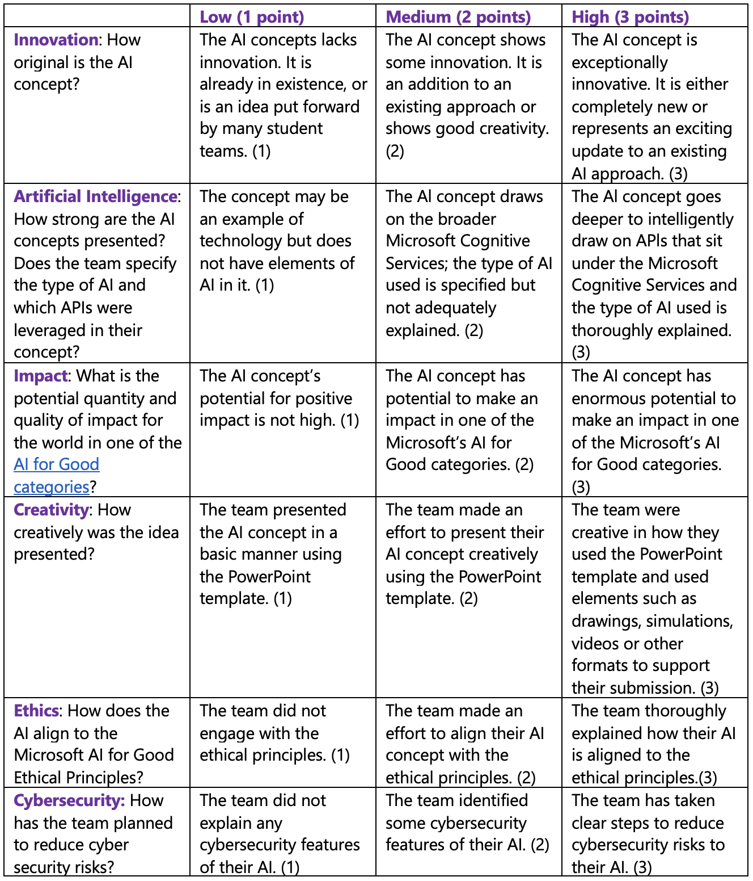
Judging Rubric
This is the rubric used by the judges to assess your student’s submissions. You can share this with your class and use it to guide their AI concepts as they fill out their PowerPoint Submission Template.
Notes:
Judging Rubric - This is the rubric used by the judges to assess your student’s submissions. You can share this with your class and use it to guide their AI concepts as they fill out their PowerPoint Submission Template.

